Slide 1
Distance Education at the University of the West Indies: Evolution, Achievements and Challenges
International Conference on Distance Education (CIAED) Salvador – Bahia, Brazil
September 9 – 13, 2013

Slide 2
Purpose
Share information on the evolution of Distance Education at the University of the West Indies
Highlight some of its successes
Mention some of its challenges and prospects

Slide 3
UWI at a Glance
Established in 1947 as a College of the University of London, became a full university in 1960
A publicly funded regional university serving 16 contributing Caribbean countries with Bermuda being our newest member and including Anguilla, Antigua, Bahamas, Barbados, Belize, BVI, Cayman Islands, Dominica, Jamaica, Grenada, Montserrat, St Kitts, St Lucia, St Vincent & the Grenadines, Trinidad and Tobago

Slide 4
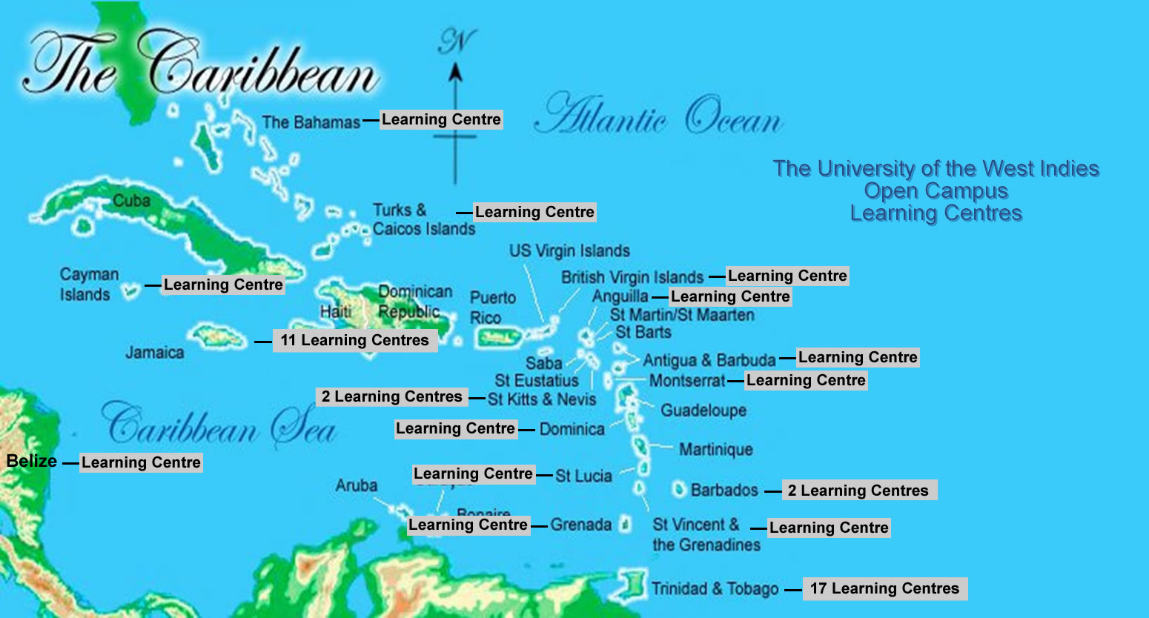
Open Campus – Locations
4

Slide 5
UWI at a Glance
4 campuses:
Mona in Jamaica,
St Augustine in Trinidad and Tobago,
Cave Hill in Barbados and
Open Campus distributed in all the contributing countries
Combined Students – about 59,000 undergraduate and graduate with about 6,000 graduates each year.

Slide 6
Factors having the greatest impact on higher education

Slide 7
Evolution of DE
 | Print | Radio | Tele conference | Video conference | Online
1947 extramural |  | x
1977 Challenge | x
1982 UWIDITE | x |  | x
1996 UWIDEC | x |  | x | x
2007/8 Open Campus | x |  |  | x | x

Slide 8
Extramural Studies
Adult education
Cultural studies
Public lectures
Refresher courses
Stimulation of intellectual thought and objective enquiry

Slide 9
Challenge Examinations
Printed course materials
Independent study and face-to-face tutorials
Invigilated examinations

Slide 10
UWIDITE
“ the signal travels by a four-wire telephone line to the Kingston offices of Jamaica International Telecommunications Company and thence by microwave circuit to their satellite ground station located at Prospect Pen in the eastern part of the island. It is relayed via INTELSAT Flight 4 Satellite …. to Trinidad, and by way of a microwave link to Cable and Wireless Offices in St Lucia which is the hub of the system. From there it goes out to the international gateways in Dominica, Antigua and Trinidad by microwave circuits and to Barbados by tropospheric scatter. The final link to all University Sites is by four- wire telephone lines.”
Lalor and Marrett, 1986: 16 in Fergus et al

Slide 11
UWIDEC
face to face or distance delivery or a combination of both
Staff were expected to function in a dual mode environment which rewarded contribution to Distance Education

Slide 12
UWIDEC operational principles
Using UWI faculty as first choice
Equivalence in content between face to face and distance offerings
Reducing dependence on face to face interactions and improving the use of in- built, self- instructional courseware.
Standards - regulated course packages and assessment.

Slide 13
UWIDEC in transition
Coordinators and e -tutors directly contracted, oriented, trained and evaluated by UWIDEC.
Independent budget and financial management.
Adaptation of the University’s Quality Assurance system to include criteria for quality assurance of DE programmes including a focus on the curriculum and learning transactions, support services and resources.

Slide 14
The Open Campus Mandate
“expand the scope, increase the appeal and improve the efficiency of UWI’s service to its underserved communities in all contributing countries and beyond.”
guided by the UWI’s mission and vision and spelt out in its own guiding principles that “the high quality education, research and services available at UWI should be open and available to all who wish to reach their full potential inside and outside the Caribbean.”

Slide 15
Open Campus Arrangements
DE and Online policy (2009) for the UWI including arrangements to deal with online programmes which had been developed by a physical campus prior to the establishment of the Open Campus.
agreement on the future use of common standards, a common platform and common templates and protocols for the development and delivery of online courses

Slide 16
Learning Exchange

Slide 17

Academic Programming Approach
Programme Laddering
UWI Writers
External Writers
Academic Support
Team
Course Development
Team

Slide 18
Some Open Campus Statistics
over 6,000 students in blended and on line bachelor’s and masters degree programme
about 20,000 in short adult and continuing education programmes and courses offered face- to face.
There is a large gender imbalance with about 80% females to 20% males.

Slide 19
OC Student Profile
The average age of the total student population is about 35 years
A recent review of the Management Studies programmes reported mean age of 32 years, minimum age of17 years, maximum of 67
There were approximately 5 female students to every male

Slide 20
OC Student Profile
The average completion time for the degree was found to be about 5.6 years and
the most frequently awarded degree was Lower Second Class Honours for both males and females.
Student Satisfaction surveys showed that about 86% of students found the programme satisfactory, good or excellent.

Slide 21
OC Achievements
established regulations and operational guidelines to support the design, development and delivery of programmes and courses.
established quality management policies and practices
documented guidelines to inform Quality Assurance practices and support programme planning and development processes.
software acquisition, in particular, Blackboard Collaborate to provide students with synchronous teaching and learning support .

Slide 22
OC Achievements
mid-semester and end of semester evaluations and feedback loops
tutor to student ratios of 1:25 and 1:30 for on line and face to face courses respectively.
restructuring of the Academic Programming and Delivery Division (APAD) from organisation by level to organisation by function

Slide 23
OC Achievements
greater acceptance of the Open campus degree as equivalent to those of the other campuses,
commitment by governments to fund Open Campus Online degrees and
accreditation of the Open Campus and recognition of its degrees by several accreditation boards in the region.

Slide 24
OC Challenges
potential competition among other campuses with e- learning ambitions
competing views related to intellectual property rights and open education resources privileges
ownership of programmes and students in a centralised distance education environment which depends on the services of campus based faculty where a funding formula is based on FTEs

Slide 25
OC Challenges
incentives for cross campus collaboration
agreement on a cost sharing intercampus model
finding and financing an appropriate student management system that can better meet the needs of a dispersed and multi currency environment in a region with variable connectivity

Slide 26
Drivers and Shapers of DE at UWI

Slide 27
Where do we go from here?

Slide 28

Oriens Ex Occidente Lux
“A Light rising from the West”

Slide 29

Thank You
Vivienne Roberts

